Slide 1
Final Project
Visualization of Nezha: The Devil Boy Churns the Sea comments

Slide 2




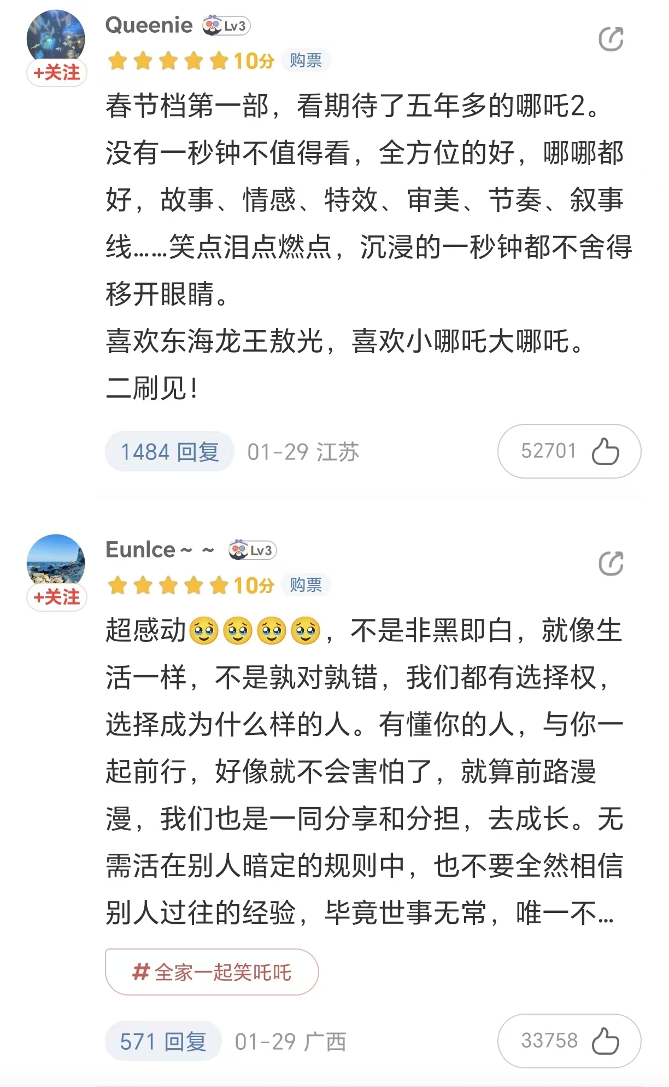


Dataset and Preprocess
1026 valid data items:
score
content
gender_mapped
sentiment
province
Removing Duliciate
Running Sentiment Analysis
Mapping the City to Province
Plotting Wordcloud
1,326 user comments

Slide 3
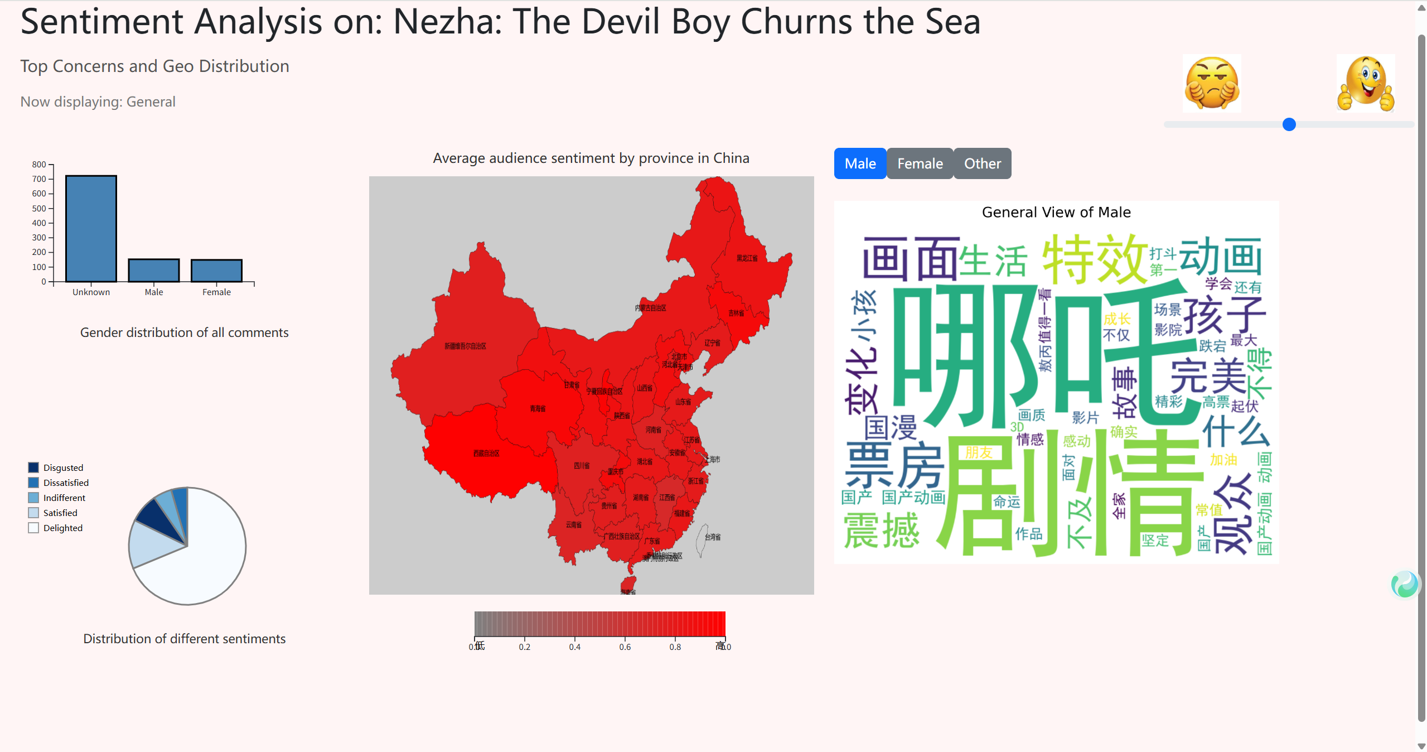
Design
An Interactive Visualization with:
Bar Chart: howing the Gender Breakdown
Pie Chart: Showing the Sentiment Distribution
Geomap: Showing Spatial Pattern
Wordcloud: Showing Top Concerns

Slide 4
Goal

